Slide 1
Japanese Etiquette: A Basic Introduction
2019 Q&A
Session

Slide 2
General Culture Overview
High context
Hierarchical Society
Strict adherence to cultural norms
Collectivistic
Notes:
High context
‘Read the air’
Value close and stable relationships (takes time)
Collectivistic (as experienced by Western cultures)
Saving ‘face’
Harmony of the group
Borderline Hierarchical society
Great respect for elders
Great respect for people in higher positions
Strict adherence to cultural norms, standards, expectations

Slide 3
Self-Introductions
Jiko-shoukai integral during your first few weeks/months
Use standard Japanese phrases
Hajimemashite
Yoroshiku onegaishimasu
Last name → First name
Occupation
Bow (not while talking)
Deep bow
Exchange business cards (and/or gifts)

Slide 4
Everyday Etiquette
The Dos
Introduce yourself
Bow
Dress modestly
Remember your role as a ‘cultural ambassador’
Address with last name and honorifics (-san, -sensei, etc.)
Sort trash properly!
The Don’ts
Give handshakes or hugs as greetings
Wear outdoor shoes indoors (if there are indoor shoe rules)
Talk loudly
Talk highly about yourself too much

Slide 5
Workplace Etiquette
The Dos
Give a greeting when arriving and leaving every day
おはようございます (Ohayo gozaimasu)
お先に失礼します (O-saki ni shitsureshimasu)
Use keigo or ‘long-form’ Japanese
Bow
‘Test the water’ (根回し ねまわし)
At work related enkai/nomikai
Many rules for pouring drinks and drinking
Leave enkai conversations at the enkai
The Don’ts
Refrain from private life conversations
Be late!

Slide 6
Public Transit/Driving Etiquette
Dos
Stand to the left side (Kanto) or right side (Kansai) of the escalator
Line up for the train (if at a busy station)
Move to the side when train doors open
Give seat up to those who need it
Use hazard lights to say ‘thank you’ when driving
Don’ts
Talk on your phone
Chat loudly (esp. rush hour times)
Honk horn (unless necessary)
Keep backpack on in crowded trains

Slide 7
Eating Etiquette
Dos
Learn how to use chopsticks (and chopstick etiquette)
Hold dishes close to your mouth when eating
Stay itadakimasu before and gochisousama after meals
Make noises when eating
Don’ts
Pass food between chopsticks
Waste food (esp. at school lunches)
Eat and walk (exception: festivals)
Tip the waiter (no tipping)

Slide 8
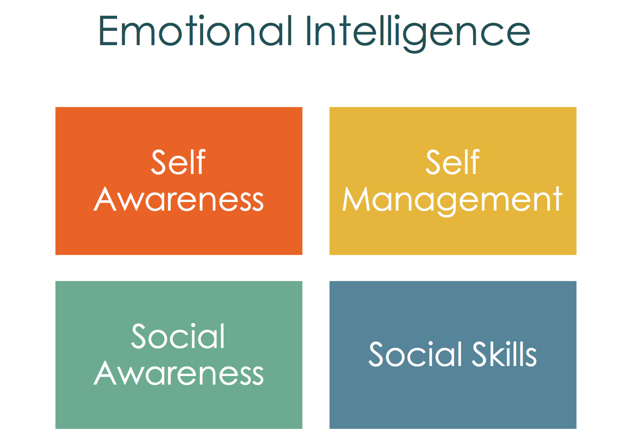
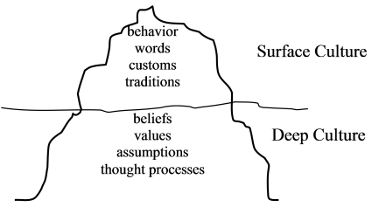
How to Address Culture-related Frustrations/Emotions
Use realistic cultural empathy!
Put yourself in the other person’s shoes
Know yourself
Practice self-reflection/introspectiveness or mindfulness
How will your message be received?
Remind yourself you are the visitor in someone else’s country
Emotional intelligence
Get together with your expat friends to decompress

Slide 9
Final Advice/Tips
Useful Resources
Do your homework!!
Anticipate → adapt
Keep an open mind
Approach each new and unfamiliar situation cautiously and respectfully
Observe first and then act
Observe and take note!
Making mistakes is part of the process
Tofugu (& other JPN related websites)
JET-related Facebook groups
The Japanese Mind by Osamu Ikeno and Roger J. Davies
Predecessor/ALTs/CIRs in your placement
2019 JET Program Survival Guide!

Slide 10
Questions?

